Slide 1

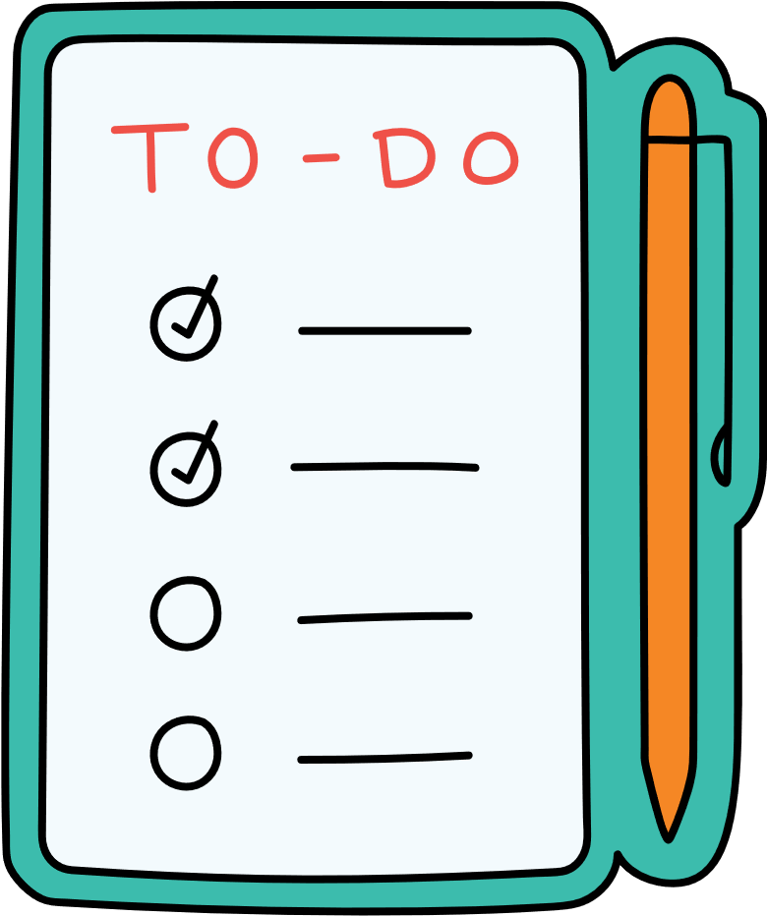
To-Do-List
Asim Sawafta : 202111479
Ameena Rabaya : 202111028
Moshera Saaidah : 202110963
Dr.Mujahed Alyat

Slide 2

Functional Requirement
1.Create Account
2. Add Tasks
3. Edit Task content
4. delete the Task
5. Add sub Task for each Task

Slide 3
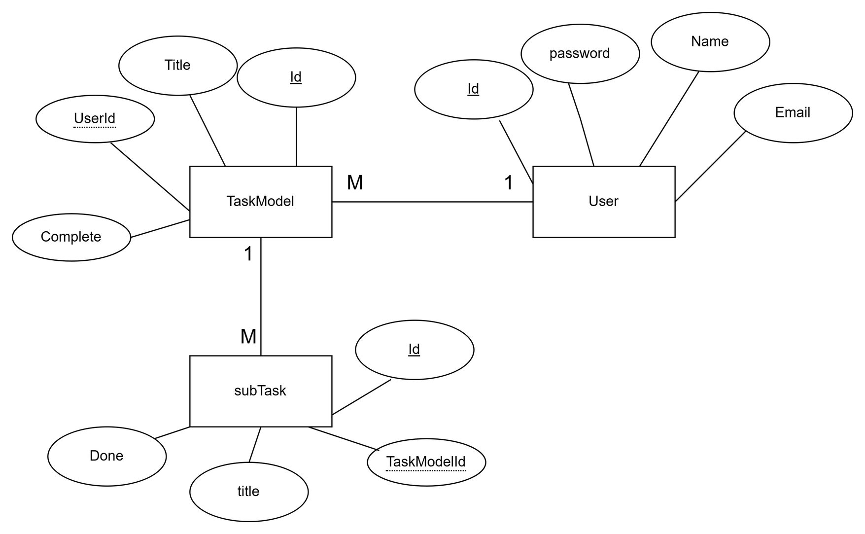
ERD:

Slide 4
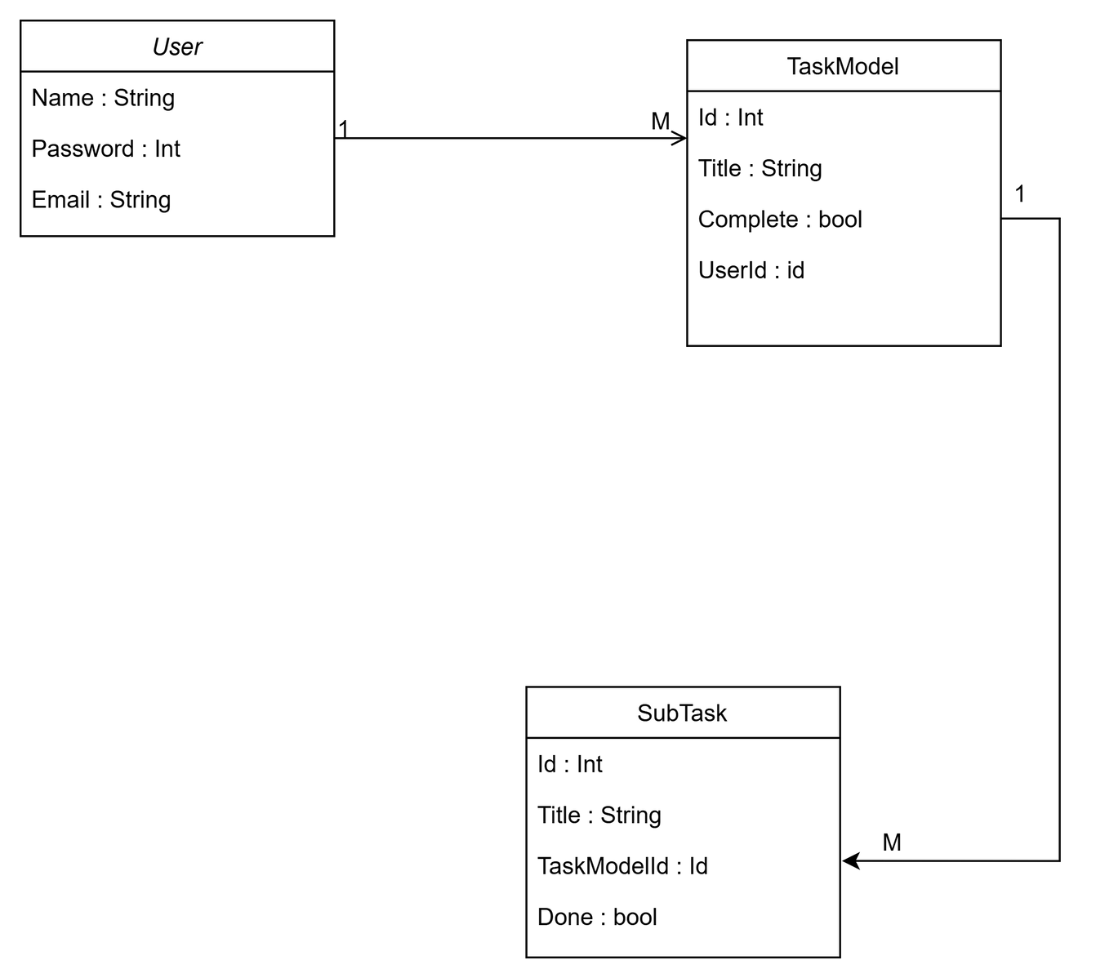

Class Diagram:

Slide 5
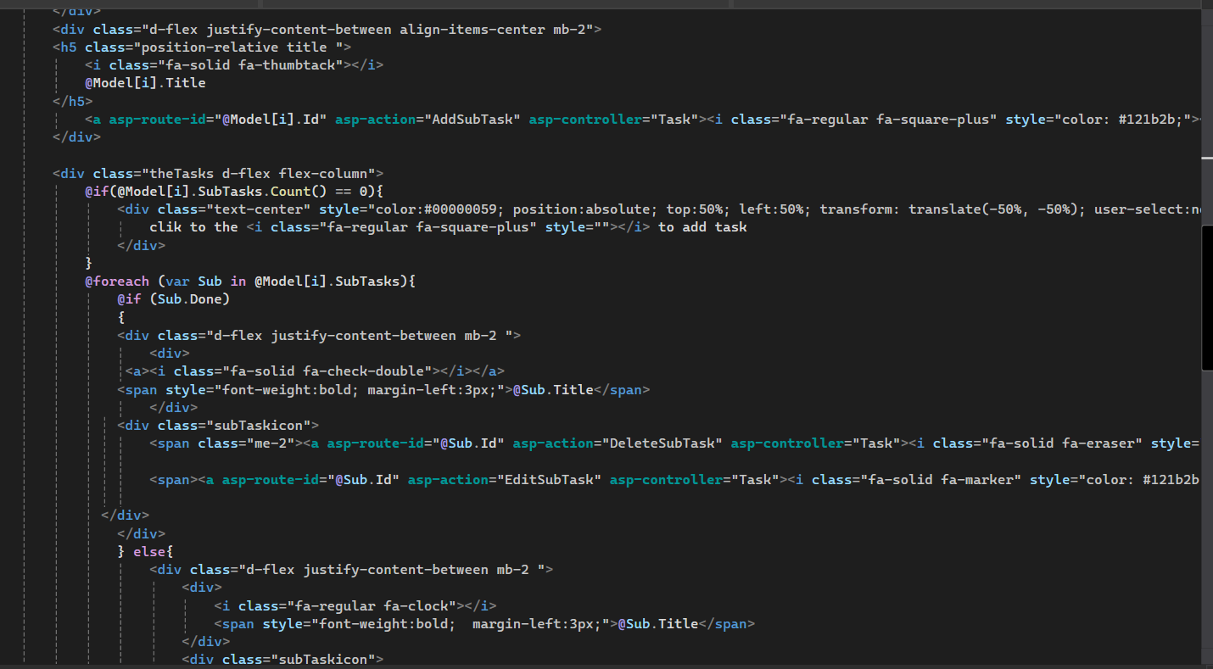
Add sub Task:

Slide 6
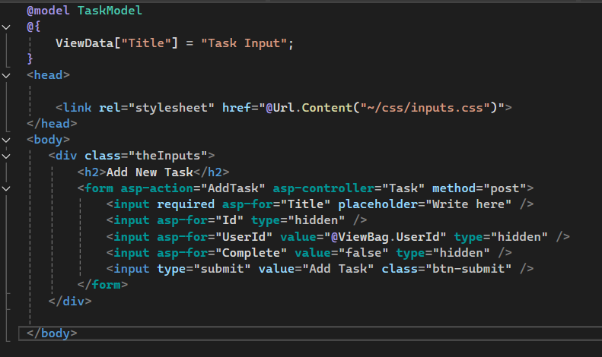
Add Task:

Slide 7
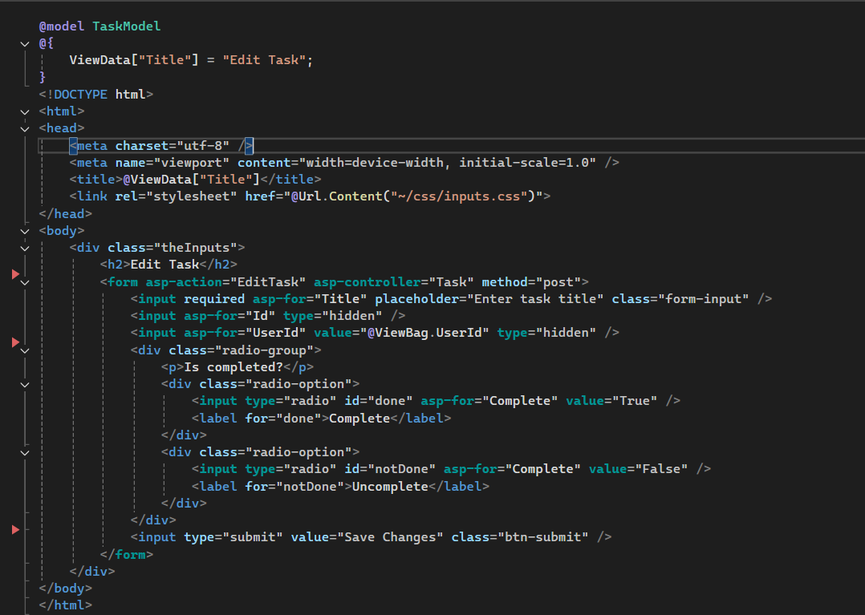
Edit Task:

Slide 8
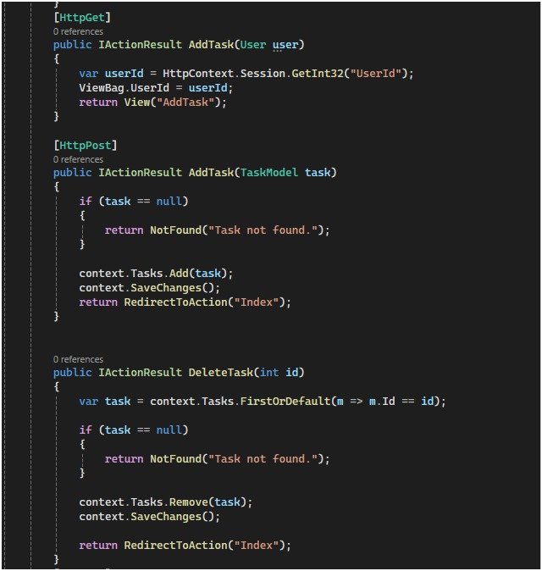
Task Controller:

Slide 9
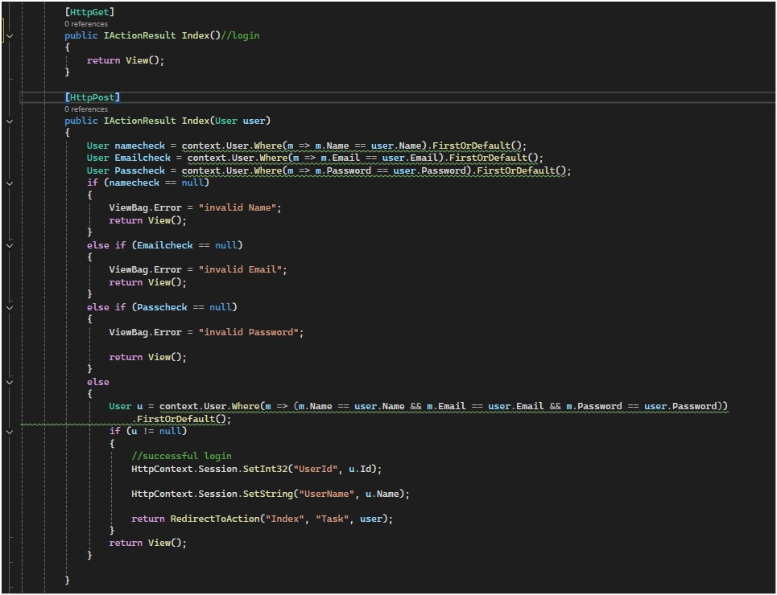
User Controller:

Slide 10
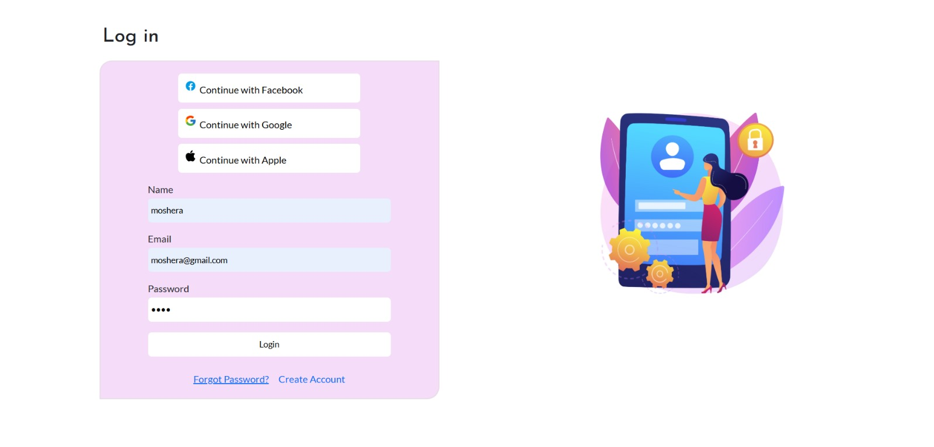

Slide 11
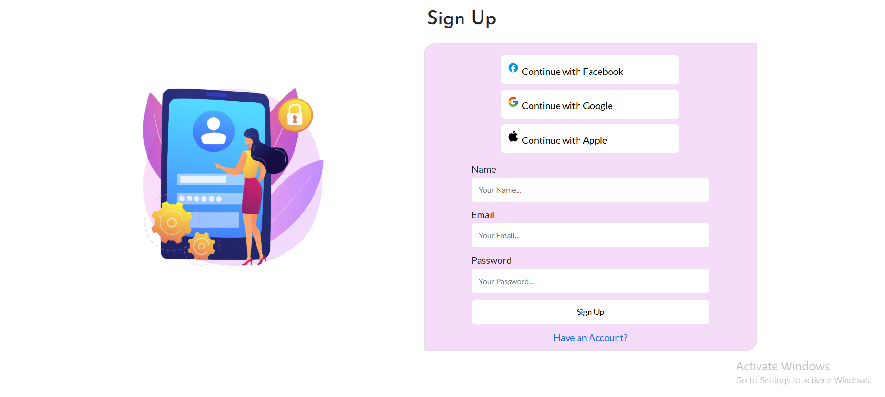

Slide 12
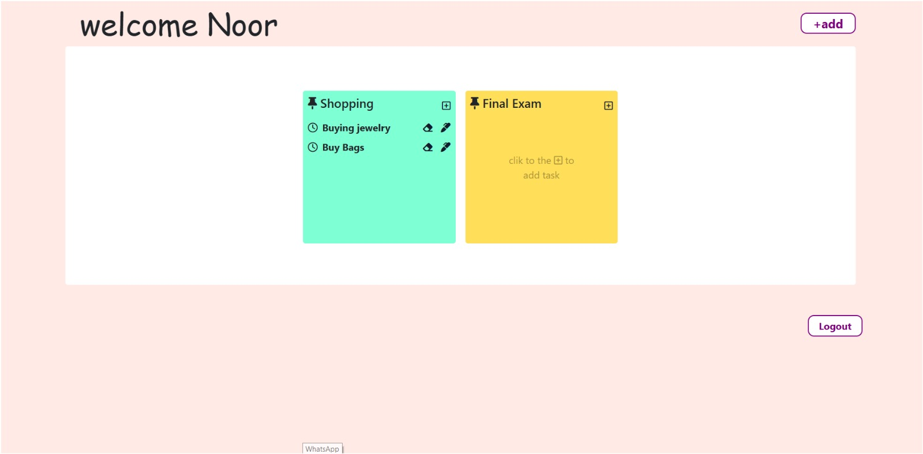

Slide 13
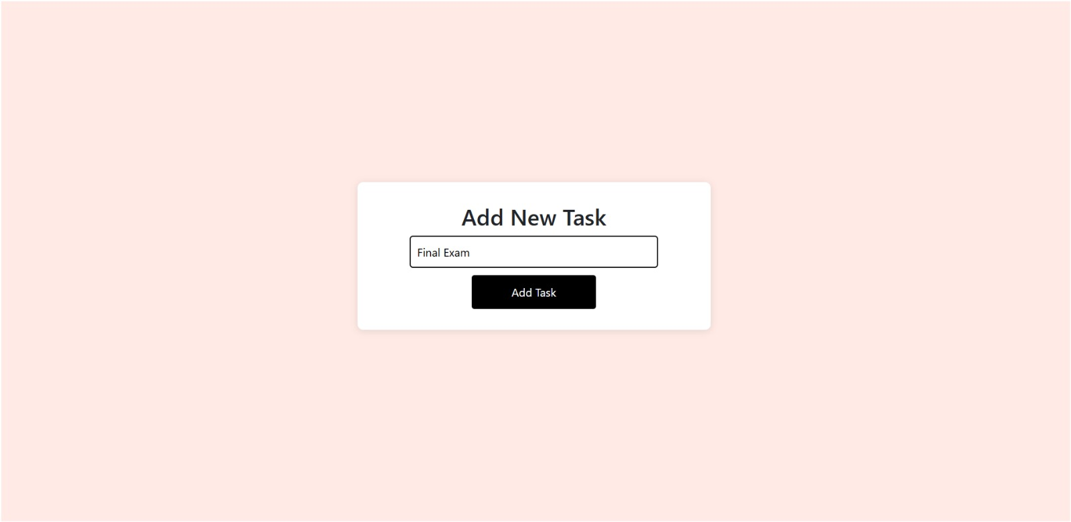

Slide 14
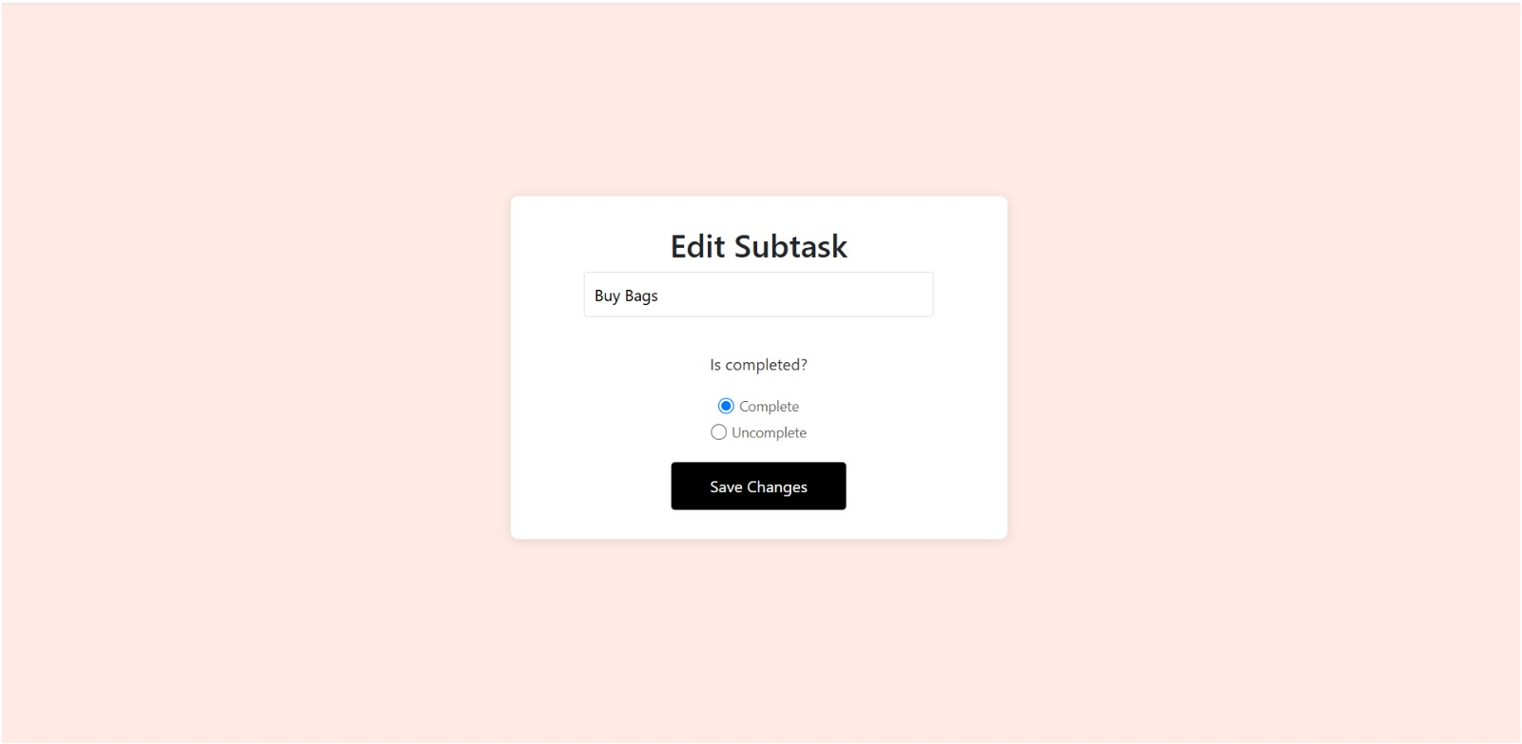

Slide 15
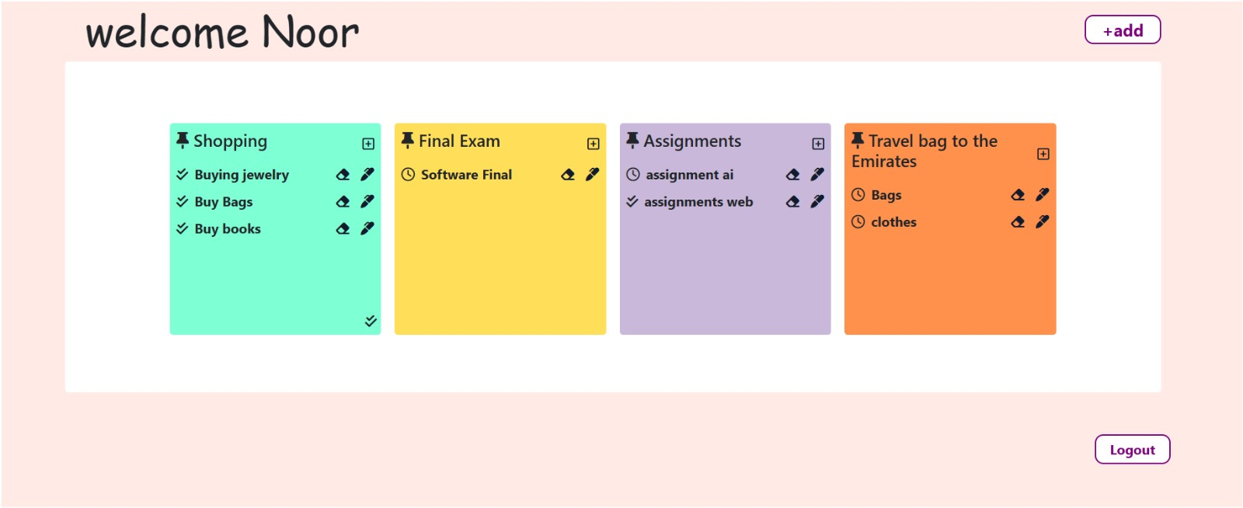

Slide 16



